Slide 1
TELECOM CHURN PREDICTION
AISC1006 - Step Presentation
Group Members:
Mohamed Maaz Rehan
Saraka Sahaswin
Rahul Batherikal
Gaurav Singh Rawat
Comfort Iroha Onuoha
Fatemi Sadikbhai Lokhandwala
Vandit Kalathiya
Dhiraj Dahal

Slide 2

Contents
Overview of the project.
Data science lifecycle.
Understanding the data set.
Gantt Chart.

Slide 3

Overview of the Project
What is churn?
The number of existing customers who may leave the service provider over a given period.
The main aim of our project is to predicting customer churn using machine learning models.

Slide 4

About our Project
Our project is targeting the number of customers who are leaving telecom industry.
Our project has dataset consisting of approximately 7000+ customers.

Slide 5
1. Business Problem Understanding
3. Data Cleaning and Preparation
4. Exploratory Data Analysis
5. Feature Learning
6. Predictive Modeling
2. Data Collection
7. Data Visualization
DATA SCIENCE
LIFE CYCLE

Slide 6
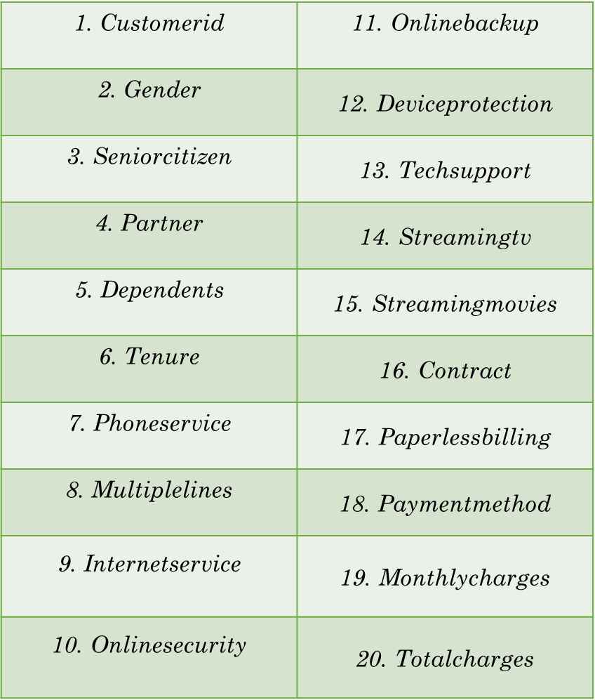

Understanding the dataset
There are 7043 rows and 21 Features (Target Variable - Churn)
21. Churn - Whether the customer churned or not (Yes or No)

Slide 7
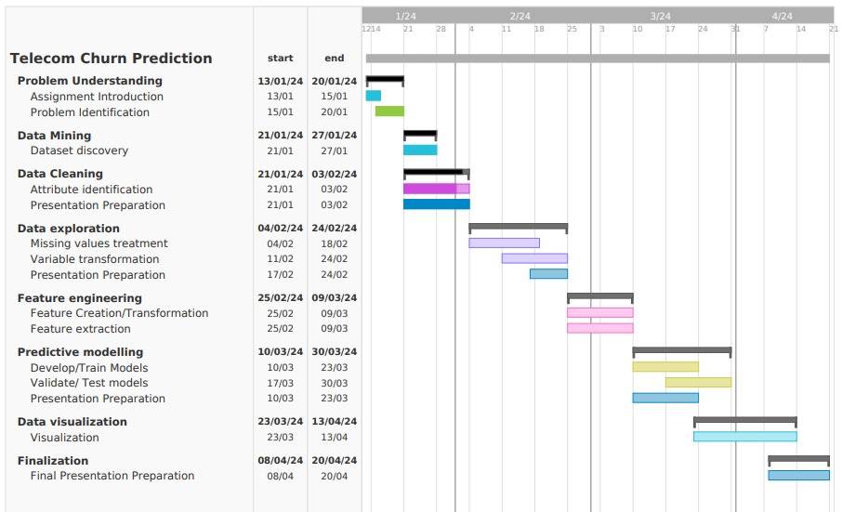
GANTT CHART

Slide 8
THANK YOU
ANY QUESTIONS?

